Slide 1
Quarterly Update on the National Inventory Collaborative
DRAFT
September 20, 2018

Slide 2
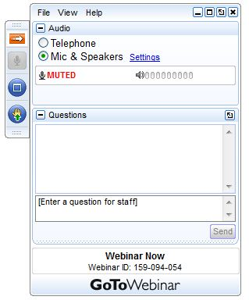
Webinar Ground Rules: Questions?
Each workgroup will give a 7 minute update introducing their group and their plans for the coming months.
All call participants will remain on mute during the webinar.
Type your questions into the question box on the webinar client.
We will try to answer questions at the end of the webinar.
We will create a Q&A document following the webinar and post with the meeting notes on the Collaborative Wiki: http://views.cira.colostate.edu/wiki/wiki/9169

Slide 3
Overview of the Platform Collaborative
A new multi-purpose emissions modeling platform (EMP) based on the 2014 National Emissions Inventory version 2 (2014NEIv2) is needed
State Implementation Plans, federal analyses
For the first time, EPA, states, and MJOs are engaging in collaborative EMP development
The 2016 base year was selected via a collaborative process
Future years selected due to regulatory relevance
2023 is relevant for Ozone NAAQS moderate areas
Although 2020 is relevant for 2015 O3 NAAQS marginal areas, modeling is not required for marginal areas; 2020 is relevant for 2008 O3 NAAQS reclassifications
2028 for regional haze

Slide 4
2016 EMP Schedule
Several versions of 2016 platform will be developed
Alpha: preliminary version based on 2014NEIv2 for some and 2016 for other key sectors (released May 2018)
ftp://newftp.epa.gov/Air/emismod/2016/alpha/
Compatible versions of 2014 and 2015 were also released
For initial testing of 2016 model runs
Beta: improved and/or new version of actual 2016 emissions for most sectors and preliminary projected emissions to 2023 and 2028 (October 2018)
V1.0: fully updated 2016 emissions and complete projected emissions for 2023 and 2028 (Early 2019)
Schedule overlaps with 2017 NEI Development
Prioritize the 2017 NEI over the 2016 platform, as needed
Any missing data for 2016 will be filled in based on 2014 NEI data and nationally consistent methods

Slide 5
Organizational Structure
Coordination co-leads: Zac Adelman (LADCO) and Alison Eyth (EPA OAQPS)
Developed process and communication structures, facilitate discussions, help resolve issues, documentation requirements, coordinate distribution of data to stakeholders
Coordination committee: regional, state, EPA leaders
Define processes, resolve issues, co-lead workgroups
Includes overall and WG co-leads plus MJO directors
Sector-specific Workgroups: one regional/state staff and one EPA staff (where possible)
Focus on preparing emissions estimates for 2016 and future years, plus improve how the emissions sectors are modeled
Include participants from EPA/states/locals/regions

Slide 6
Collaborative Workgroup Reports
EGUs
Non-EGU Point
Nonpoint
Oil and gas sources (point and nonpoint)
Onroad
Nonroad
Rail
Commercial Marine Vessels (CMV)
Fires
Biogenics
Modeling
Wrap up/Next steps
Wiki has more information and notes from each workgroup
http://views.cira.colostate.edu/wiki/wiki/9169

Slide 7
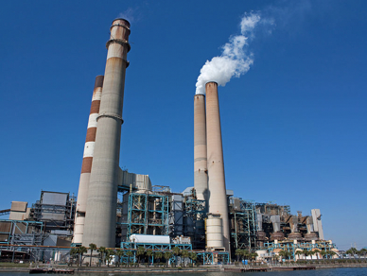
Electricity Generating Units (EGU) Workgroup
Co-leads: Julie McDill (MARAMA), Serpil Kayin (EPA CAMD), Alison Eyth (EPA OAQPS)
Schedule: Calls 4th Thursday at 2:00pm ET
Wiki: http://views.cira.colostate.edu/wiki/wiki/9174

Slide 8
EGU Workgroup: 2016 beta
Approach:
States submitted 2016 emissions for at least Type A sources
EPA collated and quality assured emissions and released inventory in June
Minor updates made post-June at request of a few states
States and EPA worked together to finalize EIS unit matches to CEMS data (CAMD/ORIS IDs), NEEDS IDs (to separate EGUs from non-EGUs), and ERTAC
Temporal profiles for EGUs without CEMS being developed
Status:
2016 emissions will be final once the cross-reference is finalized
2023 and 2028 emissions based on ERTAC-EGU and IPM being evaluated
Milestones:
Finalize cross-reference and temporal profiles over next few weeks
2016 emissions available by end of October
Develop future year projections by October-November

Slide 9
2014 and 2016 EGU Summary
There was a substantial EGU NOx and SO2 drop from 2014-2016 The vast majority of annual EGU emissions are from units with CEMS
Many Non CEMS sources are peakers and may contribute substantially on HEDD

Slide 10
EGU Workgroup: ERTAC-EGU
State review complete of
ERTAC EGU V16.0 input files
CONUS v16.0 output files
Runs with new inputs of CONUS v16.1underway
We will complete a CONUS v16.1 run for:
Base year 2016 complete by end of October 2018
Future year 2023 & 2028 complete by mid November 2018

Slide 11
EGU Workgroup: IPM
EPA launched its updated Power Sector Modeling website in June 2018, equipped with
Power Sector Modeling Resources
IPM v6 with multiple case scenario runs and Results Viewer
We are currently working on integrating latest input data and rules to the platform
Power Sector Modeling Regulatory Applications
NEEDS now have quarterly updates (latest: 9/17/2018)
https://www.epa.gov/airmarkets/clean-air-markets-power-sector-modeling

Slide 12
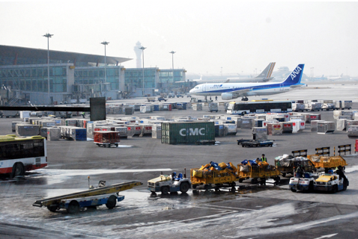
Non-EGU Point Workgroup
Co-leads: Tammy Manning (NC DEQ), Caroline Farkas (EPA)
Schedule: Calls on 3rd Tuesday at 2:00pm Eastern
Wiki: http://views.cira.colostate.edu/wiki/wiki/9177

Slide 13
Non-EGU Point Workgroup: 2016 beta
Status
Working on reviewing Control and Projection packets
Adding consent decrees to a new packet type (“allowable”)
Reaching out for new sources of information, where needed
Milestones
Expected review date: now through end of October
Expected release date: November 1, 2018
Expected projection inventory date: mostly November 1, 2018

Slide 14
Non-EGU Point Workgroup: Projections
Aircraft – projecting 2014 EDMS estimates to 2016, 2023, and 2028 for beta; will update to new FAA model (AEDT) for v1
Corn Ethanol – keeping flat (no growth)
Consent decrees – working together to identify and add recent consent decrees using “allowable packet”
Cement manufacturing – working to find new source of projections
Closures – asking states to submit closures they know are occurring by 2028 or earlier.
Removing control packets that have compliance dates prior to 2014 (e.g., RICE NESHAP)

Slide 15
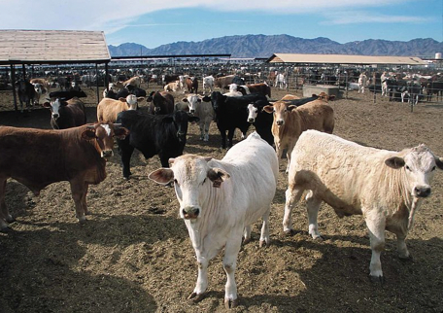
NonPoint Workgroup
Co-leads: Caroline Farkas (EPA), Jennifer Snyder (EPA)
Schedule: Calls on 4th Monday at 2:00pm Eastern
Wiki: http://views.cira.colostate.edu/wiki/wiki/9178

Slide 16
NonPoint Workgroup: 2016 beta
Status
Open burning: awaiting contractor review of data – will be in v1, not beta
Working on reviewing Control and Projection packets
Reaching out for new sources of information where needed
Milestones
Expected review date: now-end of October
Expected release date: November 1, 2018
Expected projection inventory date: mostly November 1, 2018

Slide 17
NonPoint Workgroup: Projections
Population-based Sectors - Awaiting new population data from EPA tool (ICLUS)
Fugitive Dust - No growth for unpaved roads
Agricultural Sources - Working on finalizing livestock projections
Control packets – reviewing and updating as needed, removing if full compliance date is prior to 2014

Slide 18
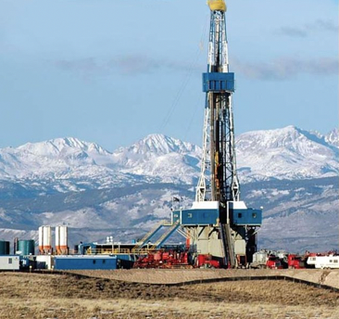
Oil & Gas Workgroup
Co-leads: Jeff Vukovich (EPA), Tom Moore (WESTAR and WRAP)
Schedule: Calls on 2nd Monday at 2:00pm Eastern
Wiki: http://views.cira.colostate.edu/wiki/wiki/9180

Slide 19
Oil & Gas Workgroup: 2016 beta
Add content

Slide 20
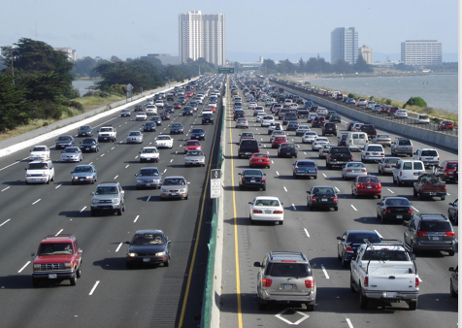
Onroad Mobile Workgroup
Co-leads: Julie McDill (MARAMA), Alison Eyth (EPA OAQPS)
Schedule: Calls 3rd Thursday at 2:00pm ET
Wiki: http://views.cira.colostate.edu/wiki/wiki/9181
Summary reports and maps for beta:
ftp://newftp.epa.gov/Air/emismod/2016/beta/reports/onroad/

Slide 21
Onroad Mobile Workgroup
Approach:
Beta emission factors output from MOVES2014a and compatible with 2014NEIv2 inputs but run for 2016, 2023, and 2028
For beta, states provided base and future year activity data; for non-submitting states, activity data projected from 2014NEIv2 to 2016, 2023, 2028
Spatial surrogate updates: On-network spatial surrogates updated using 2016 data, long-haul combination truck surrogate updated using state inputs
Status:
2016 emissions are available
Activity data projections method for 2023 and 2028 being developed
2023 and 2028 emissions coming soon
Milestones:
Release 2016 data this week
Develop and quality assure 2023 and 2028 data by end of October
V1.0 will use emission factors based on updated age distributions and populations and be available late 2018/early 2019

Slide 22
2016 beta Onroad Emissions Totals
Pollutant | 2014v2 | 2016fd alpha | 2016ff beta | 2016 beta- 2014v2 % change | 2016 alpha-beta % change
NH3 | 107,684 | 101,230 | 100,841 | -6% | -0.4%
NOX | 4,835,396 | 4,045,836 | 4,057,272 | -16% | 0.3%
PM10 | 301,467 | 272,855 | 272,879 | -9% | 0.0%
PM2_5 | 161,732 | 130,263 | 130,663 | -19% | 0.3%
SO2 | 28,094 | 27,356 | 27,262 | -3% | -0.3%
VOC | 2,346,620 | 1,961,995 | 1,950,603 | -17% | -0.6%
CO | 24,141,986 | 20,446,327 | 20,345,829 | -16% | -0.5%
Credit: US EPA OAQPS, Emission Inventory and Analysis Group

Slide 23
Total 2016 beta Onroad NOx
Credit: US EPA OAQPS, Emission Inventory and Analysis Group

Slide 24
Surrogate Update: On-network
Credit: US EPA OAQPS, Emission Inventory and Analysis Group

Slide 25
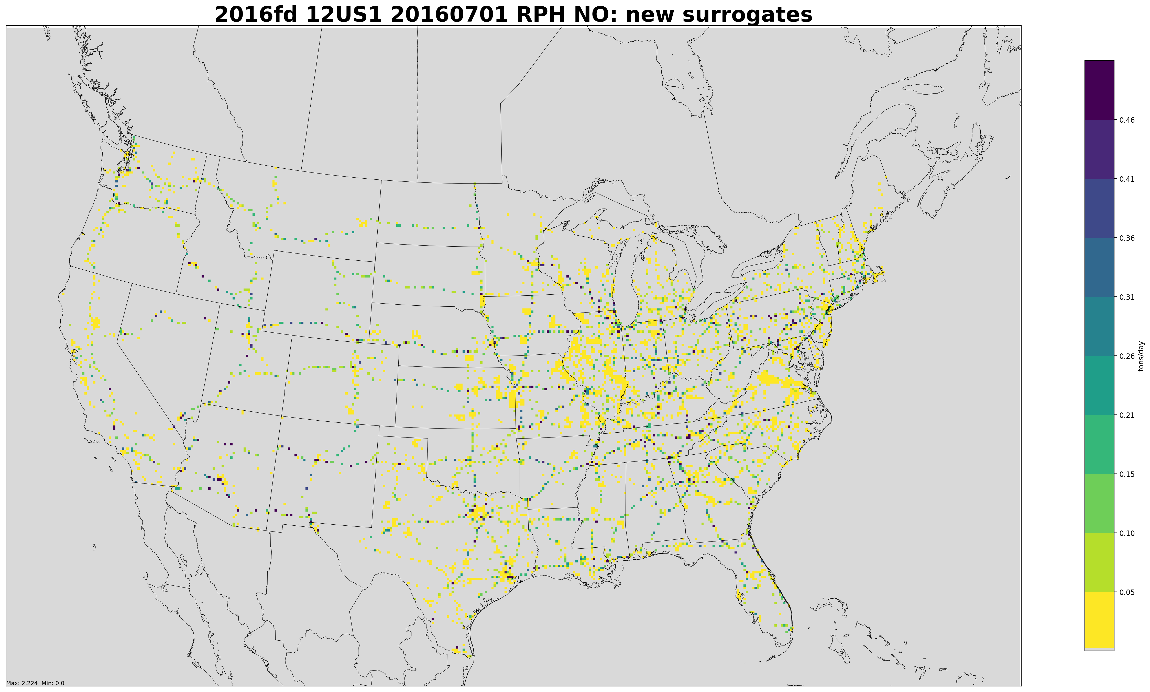
2016 beta Hoteling Surrogate and Emissions

Slide 26
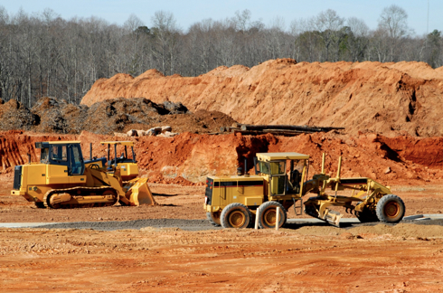
Nonroad Mobile Workgroup
Co-leads: Rebecca Simpson (Colorado Department of Public Health and Environment), Sarah Roberts (EPA OTAQ)
Schedule: Calls on 4th Thursday at 3:30pm Eastern
Wiki: http://views.cira.colostate.edu/wiki/wiki/9179
Status of the 2016 Beta Inventory: newly-released MOVES2014b will be used to generate the beta nonroad inventory and projections.

Slide 27
Nonroad Mobile Workgroup
Approach: EPA running MOVES2014b for the 2016 beta inventory and projections. Work group consensus to not include state-supplied data in the beta inventory, so that states can have the opportunity to review updated nonroad model defaults.
Status: MOVES2014b was released August 28th; model runs initiated this week. Work group concurrently working on updating the surrogate data used to allocate national- and state-level equipment populations to counties.
Milestones: aiming to release 2016 nonroad beta inventory and projections in October. Updated geographic surrogates for v1 complete by January 2019.

Slide 28
Nonroad Mobile Workgroup Updating Geographic Allocation of Equipment (v1)
Workgroup wants to improve the equipment populations of the highest-emitting nonroad categories: Construction, Agriculture, Lawn & Garden, and Recreational.
Nonroad equipment population data, however, are scarce. More feasible to adjust the model’s equipment population growth rates and/or how the model allocates national equipment populations to the county level.
MOVES2014b includes updated equipment population growth rates, so the work group is focusing on updating geographic allocation factors. Volunteers from NC, GA, CO, MA, Pima County, and EPA are researching and evaluating data sources (e.g., USDA Census of Agriculture and Farm Production Expenditures, EIA Fuel Oil and Kerosene Sales, U.S. Census Bureau County Business Patterns, NASA, CARB surveys).

Slide 29
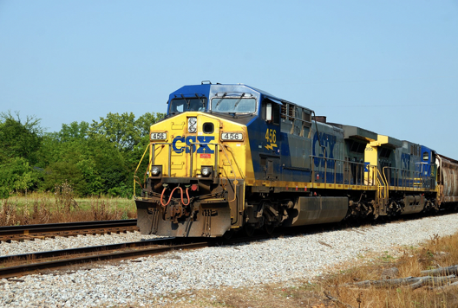
Rail Workgroup
Lead Mark Janssen (LADCO)
Schedule: Calls 3rd Thursday at 11:00am ET
Wiki: http://views.cira.colostate.edu/wiki/wiki/9182
Status of the 2016 beta Inventory
Expected completion is October 31
2017 NEI estimates by November
Will include a SMOKE Linkproc format for link-based processing

Slide 30
Rail Workgroup: 2016 beta
Emissions calculated for Class 1 & 2/3 line haul
Link-level estimates for Class 1 Line Haul (85% rail NOx emissions).
Similar to traditional methods
Integrating sources for rail yard estimates
Complete upgrade from past inventories: UP, BNSF, KCS
LADCO/IL/MI gap filled CP and CN
GA and ME filling in NS and CSX
Need state help filling in gaps by looking at Google Earth: counting switching engines
Class 2/3 and commuter rail estimates were updated for some states. Can be significant
Company specific Fleet Mix and link level also possible.
Including AMTRAK in Class 2/3

Slide 31
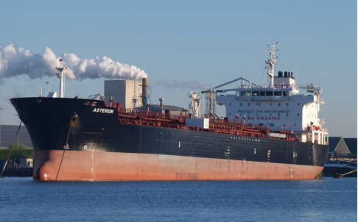
Commercial Marine Vessel (CMV) Workgroup
Lead Mark Janssen (LADCO)
Schedule: Calls 3rd Tuesday at 3:00PM ET
Wiki: http://views.cira.colostate.edu/wiki/wiki/9176
2016 beta = 2016 alpha = 2014v2
Status of the 2016 Version 1 Inventory
Expected completion is February 2019
EPA will build 2017 NEI estimates for Ocean going (Category 3) vessels for December deadline
Will include a SMOKE Linkproc format for link-based processing

Slide 32
CMV Workgroup: Methodology
OTAQ finished draft power model to calculate Class 3 large vessel power
Model released to beta testers
Read AIS data and do spatial attribute checking
OAQPS has a work assignment to build the 2017 NEI inventory for marine from AIS. This will include Category 1 and 2 (Ocean/Great Lakes/Rivers) and Tugs at ports.
Workgroup will use these tools/methods to generate 2016 estimates in parallel with 2017

Slide 33
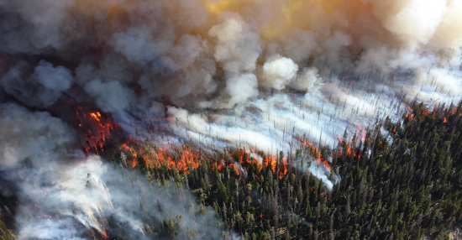
Fire Workgroup
Co-leads: Jeff Vukovich (EPA), Tom Moore (WESTAR)
Schedule: Calls on 1st Thursday 1PM ET
Wiki: http://views.cira.colostate.edu/wiki/wiki/9175
Google Drive: https://drive.google.com/drive/folders/14e4iqUv64z1eC71BHyYPaj09I-kt1MBW
Includes wildfires, prescribed fires and agricultural burns

Slide 34
Fire Workgroup: 2016 beta
New data acquired
Seven states and one tribe voluntarily submitted fire activity and/or emissions data (CO, GA, ID, KS, MN, NC, WA and Nez Perce tribe)
National fire information and polygon data acquired
National Association of State Foresters (NASF): wildfires
ICS-Planned Ignition Release (PIR) data: prescribed fires
Monitoring Trends in Burn Severity (MTBS) shapefiles: wildfires and prescribed fires
Approach
Continue to use SmartFire2 and BlueSky modeling framework (same versions as in 2016 alpha)
Agricultural burns emissions estimates done separately (G. Pouliot)
Implement new data in best way possible
Update fuel-bed information in BlueSky (higher resolution and more current database (year 2014) data will be used)
Grassland fires moved from Ag burn (Pouliot) processing to SmartFire2 + BlueSky modeling framework

Slide 35
Fire Workgroup: 2016 beta
Status
Processing has already begun using new data
QA has also begun at various steps in the fire emissions modeling process
Milestones
Expected review date: early October
Expected release date: October 31, 2018
Projections:
None planned; possible for 2016v1

Slide 36
Biogenics Workgroup
Co-leads: Jeff Vukovich (EPA), Doug Boyer (TCEQ)
Schedule: Calls on 3rd Tuesday 330PM ET
Wiki: http://views.cira.colostate.edu/wiki/wiki/9172
Google Drive:
https://drive.google.com/drive/folders/1ulLmJPQ1WkOnsi6_g2nkHLWfqJEw4RSU

Slide 37
Biogenics Workgroup: 2016beta
Models
Biogenic Emissions Inventory System version 3.61 (BEIS3)
Model of Emissions of Gases and Aerosols from Nature (MEGAN) version 3 beta
Approach
Execute annual simulations for both BEIS3 and MEGANv3
Examine and quality assess input data (e.g. landuse)
Emissions comparisons
Research availability of emissions flux observational data

Slide 38
Biogenic Workgroup: 2016 beta
Status
MEGANv3 beta “default” configuration run complete
BEIS3 run complete
Considering small landuse change and rerun in short-term
Quality assurance steps and comparisons continue
Milestones
Expected release date: October 31, 2018
Release will include both BEIS3 and MEGANv3 gridded emissions
Projections:
None planned

Slide 39
Emissions Modeling Workgroup
Co-leads: Husain Waheed (MD Dept of Environment), Zac Adelman (LADCO) [Interim]
Schedule: No call schedule yet, starting in October 2018
Wiki: http://views.cira.colostate.edu/wiki/wiki/9190
Objectives:
Gather, test, and prepare the emissions data platforms created by each of the inventory sector workgroups for use in air quality modeling.
Produce an emissions modeling platform for modeling 2016 and projection years.

Slide 40
Modeling Workgroup: Tasks
Testing and Platform Development
Assess availability of 2016 meteorology
Emissions modeling protocol and platform creation
SMOKE modeling
Data validation
Platform Packaging
Create an emissions modeling package with data and software needed to prepare the emissions for air quality modeling
Develop an approach (and document) how to customize the base emissions modeling platform
Documentation and Evaluation
Provide feedback to inventory sector workgroups on their documentation
Model performance evaluation of the 2016 base modeling
Create best-practices guidance for using the Collaborative data for modeling

Slide 41
Inventory Collaborative Next Steps
Workgroups will be prioritizing their work to produce version 1.0 of the 2016 inventory by spring 2019; including projections to 2023 and 2028
Collecting information on prospective uses of the alpha and beta platforms: let us know
Quarterly outreach calls by the Collaborative to report out on progress: mark your calendar
Next outreach call:
December 19 at 12:00 Eastern

Slide 42
Inventory Collaborative Wiki
These slides, answers to the questions posed during this webinar, notes:
http://views.cira.colostate.edu/wiki/wiki/9193
Main National Inventory Collaborative Wiki includes live workgroup wikis, documentation, calendar:
http://views.cira.colostate.edu/wiki/wiki/9169

